Slide 1
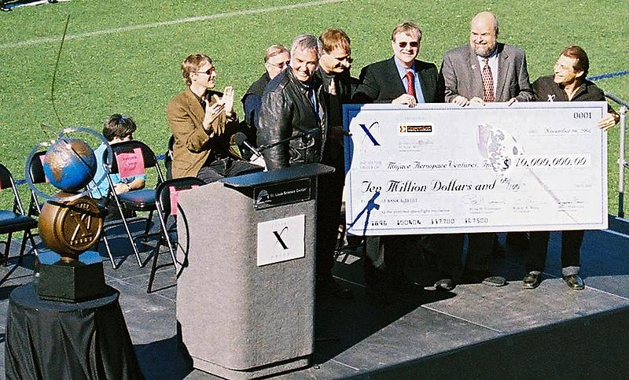
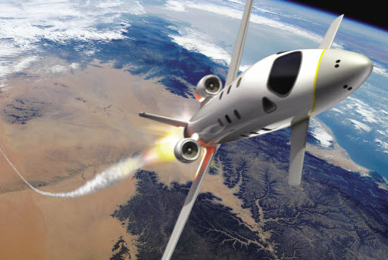
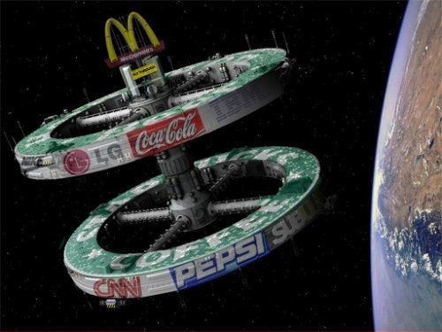
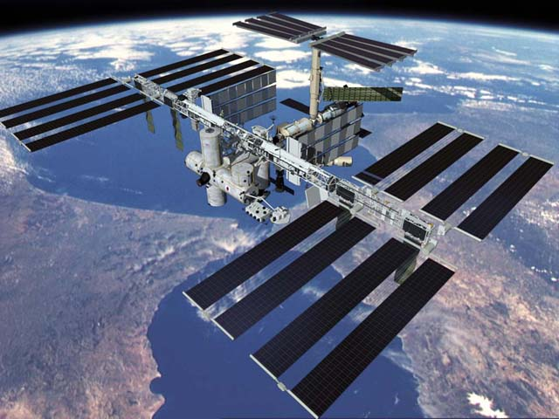
Space Tourism
Prasanna Deshapriya
Undergraduate
University of Colombo
Sri Lanka

Slide 2
Overview
Introduction
Early dreams
Space Tourists
Proposed orbital Ventures
More affordable suborbital flights
X-prize
Virgin Galactic – The Richard Branson affair
Legality
Environment Issues
Influence on Economics
Space Passport ?

Slide 3
Introduction
Space travel involved with leisure or business purposes can be identified as Space Tourism. With recent launches it has been apparent that the attention drawn towards space tourism is highly rising in an environment where lots of companies are gathering up around the industry. However this expensive facility of traveling was being offered by Space Adventures, Ltd while transport being offered only by Russian Space Agency. Generally it has cost between US$20–40 million for a trip to the International Space Station (ISS) and back during the period of 2001-2009 aboard a Russian Soyuz for an individual. It has also been the case that some space tourists have signed contracts with third parties to conduct certain research activities while in orbit.
In 2010, Russia halted their orbital space tourism facility due to the increasing size of the crew in the International Space Station. As of now, January 2013, tourist flights to space are to resume this year, when the number of single-use three-person Soyuz launches could rise to five a year, along with the commercial space flights offered by groups such as Virgin Galactic

Slide 4
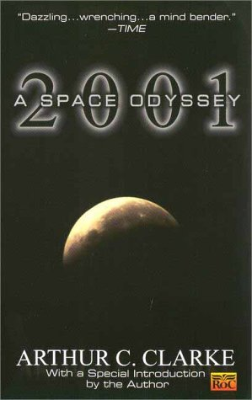
Early Dreams
A Fall of Moondust, 2001: A Space Odyssey – Sir Arthur C Clarke
Charlie and the Great Glass Elevator – Roald Dahl
From the Earth to the Moon, Around the Moon – Jules Verne
Picnic on Paradise – Joanna Russ
The Menace from Earth – Robert A Heinlein

Slide 5
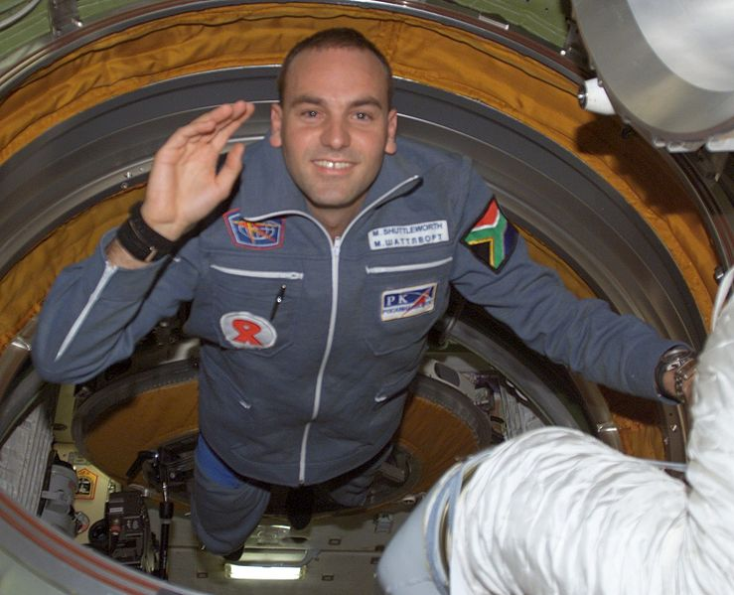
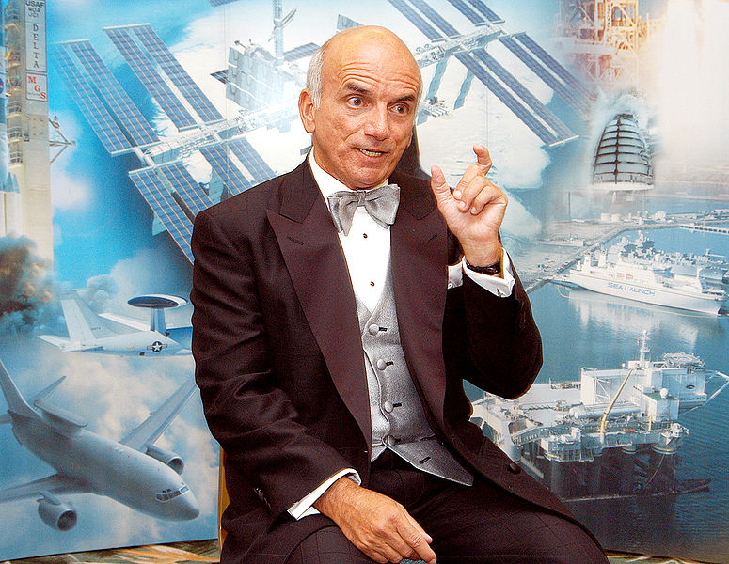
Space Tourists
Dennis Tito – American/ Italian – 2001
Mark Shuttleworth – South African/ British – 2002
Gregory Olsen – American – 2005
Anousheh Ansari – Iranian/ American – 2006
Charles Simonyi – Hungarian/ American – 2007, 2009
Richard Garriott – American/ British – 2008
Guy Laliberté – Canadian – 2009

Slide 6
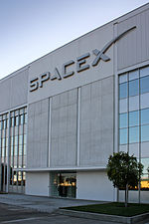
Orbital Ventures
SpaceX- A private space company that develops their own rocket family called “Falcon” and a capsule named “Dragon” capable of sending up to 7 people to any space station. Falcon 1 – tested successfully deploying Malaysian RazakSAT into orbit in 2009. Dragon would be ready for human within 3 years of the receipt of NASA CCDev (commercial crew development) funding. In 2012, an unmanned variant of Dragon made a successful rendezvous with the ISS, becoming the first commercial spacecraft to do so.

Slide 7
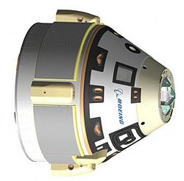
CST-100 (Crew Space Transportation) by Boeing as a part of CCDev of NASA - in progress at the moment
DSE-Alpha, a circumlunar mission to Moon by Space Adventures Ltd.
Current Offers
Lunar Mission
Orbital Spaceflight
Suborbital Spaceflight
Zero Gravity Flight
Space Adventures - the only company to have sent private citizens to space

Slide 8
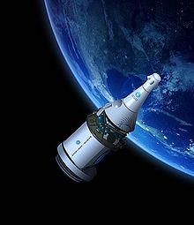
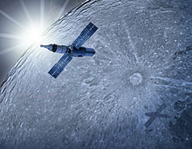
Excalibur Almaz- A private company based in Isle of Man, plans to send paying research crews to low-Earth orbits and beyond, using modified TKS (Soviet) capsules. Tickets have been announced to be available and voyages are to commence in 2015.
Unmanned micro-gravity scientific research missions
Human transportation including crew and tourism
3) Cargo delivery and return
4) Chartered space exploration
Space Hotels – Bigelow Aerospace, Space Island Project (20,000 people by 2020 in the habitats)

Slide 9
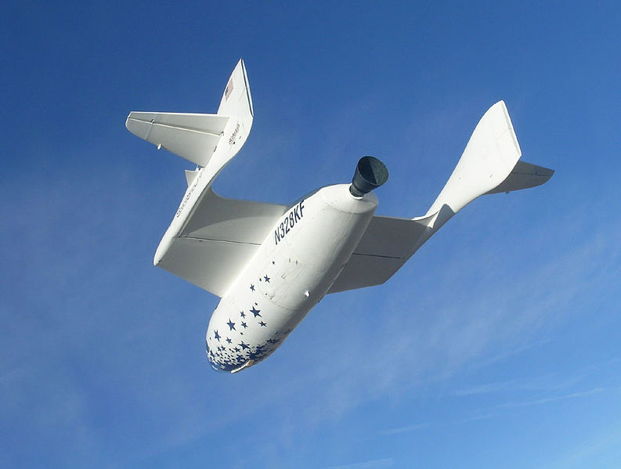
More affordable Suborbital Flights
Although there is no any suborbital space tourism taken place yet, there exist possibilities of tourists flights to sub-orbits since it’s more affordable.
There are many companies that have identified this situation as a profitable venture and a money-making proposal.
There are proposals of potential vehicles to reach sub-orbits of altitudes of about 100-160 km. During the flight, the passengers are expected to experience the effect of weightlessness for about 3-6 minutes, a view of a twinkle-free star field, plus the view of the curved Earth beneath. Projected costs are expected to be about $200,000 per passenger.
Space Ship One
In 2004, Space Ship One, designed by Burt Rutan of Scaled Composites, won the X Prize (Ansari X Prize), worth of $10,000,000 and it was designed to be won by the first private company who could reach and surpass an altitude of 62 miles (100 km) twice within a matter of 2 weeks. This altitude is beyond the Kármán Line, which is the arbitrarily defined boundary of space. The first flight was flown by Michael Melvill on June 21, 2004, to a height of 62 miles, making him the first commercial astronaut.

Slide 10
X-prize (Ansari X prize)
First proposed by Dr. Peter Diamandis
http://www.youtube.com/watch?v=cz24s85GVU0&feature=player_embedded
Revolutionized the spaceflights making it no longer a monopoly of the governments.
http://www.youtube.com/watch?v=JbNAvhcoIRQ&feature=player_embedded

Slide 11
"I think the [Ansari] X PRIZE should be viewed as the beginning of one giant leap..." Dr. Buzz Aldrin NASA Astronaut Apollo 11
"We consider the X PRIZE competition a new space race, even though this time the prize in not the Moon. It will open access to space for all of us, forever. Because of that, this competition is the most challenging competition ever addressed to private industry in astronautics. People all over the world are passionate about astronautics. Like all competitors, we are convinced that they want to feel what it's like to go into space and what it feels like to ride on a rocket. All those people deserve to have a chance to feel all of those things, and the X PRIZE will offer them this opportunity. Sub-orbital flights are nothing new; remember Mercury missions or the X-15 program. It is obviously possible to fulfill the X PRIZE competition tasks. We are proud to compete for the X PRIZE. We are honored to take part in this adventure“
Dumitru Popescu
Team leader of rocket ORIZONT
Candidate for Ansari X Prize
Aeronautics and Cosmonautics Romanian Association

Slide 12
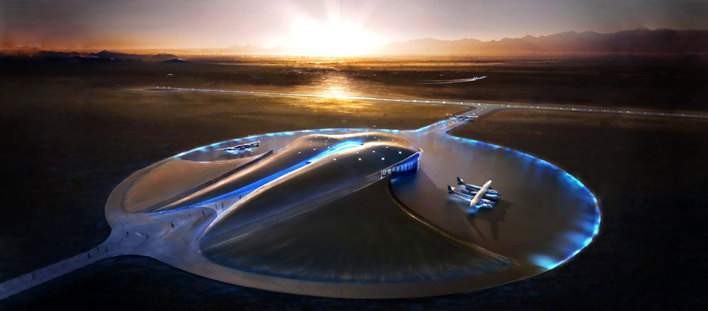
Virgin Galactic
Virgin Galactic is planning to begin passenger service aboard the VSS Enterprise, a Scaled Composites Space Ship Two class spacecraft. The initial seat price is $200,000, with a required down-payment of $20,000. It is reported that over 500 people have signed up until now. Headed by Sir Richard Branson's Virgin Group, Virgin Galactic hopes to be the first private space tourism company to regularly send civilians into space. A citizen astronaut will only require three days of training before spaceflight. Space Ship Two is a scaled up version of Space Ship One, the spacecraft which claimed the Ansari X Prize. Launches will initially occur at the Mojave Spaceport in California, and will then be moved to Spaceport America in Upham, New Mexico. Tourists will also be flown from Spaceport Sweden, in Kiruna.

Slide 13
Options
Pioneer Astronaut – The Earliest Available Seat
Deposit - US$200k full payment up front Almost first 500 seats sold out Expect to be among the first 1000 humans to have travelled to space Priority access to Galactic events, milestones and trips Pioneer welcome and confirmation package Guarantee the price of $200k for your spaceflight
Voyager Astronaut – Join the Waiting List for a Later Seat
Deposit - $20k Secure a spot on the waiting list after the first 500 to fly Take part in the Galactic milestones, events and trips Voyager welcome and confirmation package Guarantee the price of $200k for your spaceflight
Spaceship Charter (Group package)
$1 million An exclusive spaceflight for you and up to 5 friends Pioneer status for all 6 seats 6 seats for the price of 5

Slide 14
Benefits upon enrolment
Travel to see the spaceships being built in California and to Spaceport America in New Mexico to see test flights of the spaceship and carrier craft.
Training at centrifuge facility in Philadelphia and on zero gravity parabolic flights throughout the United States
Being hosted by Sir Richard Branson at his private island in the Caribbean, game reserve in South Africa, chalet in the Swiss Alps and estate in the Atlas Mountains in Morocco. Subscribers have even stayed in the Ice Hotel in the Arctic and visited Spaceport Sweden.

Slide 15
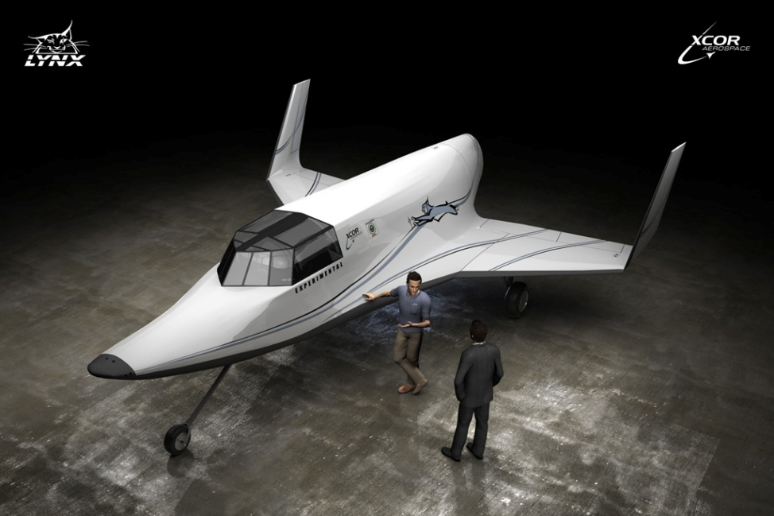
XCOR Aerospace
XCOR Aerospace is developing a suborbital vehicle called Lynx. The Lynx will take off from a runway under rocket power. Unlike both Space Ship One and Space Ship Two, Lynx will not require a mothership. Lynx is designed for rapid turnaround, which will enable it to fly up to four times per day. Because of this rapid flight rate, Lynx has fewer seats than Space Ship Two, carrying only one pilot and one spaceflight participant on each flight. XCOR expects to roll out the first Lynx prototype during the summer of 2012 and begin flight tests by late 2012. If all goes well, it is hoped that Lynx will carry paying customers before the end of 2013.

Slide 16
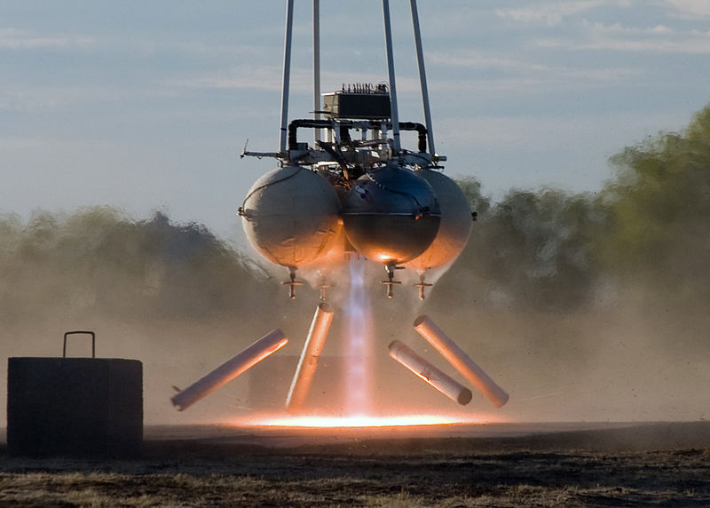
Armadillo Aerospace
Armadillo Aerospace is developing a two-seat vertical takeoff and landing (VTOL) rocket called Hyperion, which will be marketed by Space Adventures Ltd. Hyperion uses a capsule similar in shape to the Gemini capsule. The vehicle will use a parachute for descent but will probably use retrorockets for final touchdown, according to remarks made by Armadillo Aerospace at the Next Generation Suborbital Researchers Conference in February 2012.

Slide 17
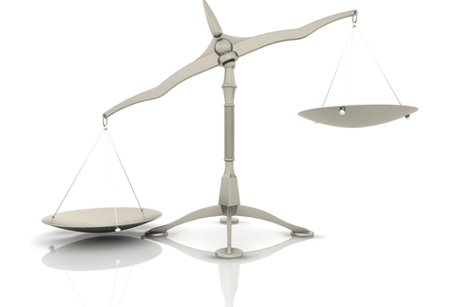
Legality
In December 2005, the U.S. Government released a set of proposed rules for space tourism. These included screening procedures and training for emergency situations, but not health requirements.
Under current US law, any company proposing to launch paying passengers from American soil on a suborbital rocket must receive a license from the Federal Aviation Administration's Office of Commercial Space Transportation (FAA/AST). The licensing process focuses on public safety and safety of property, and the details can be found in the Code of Federal Regulations, Title 14, Chapter III. This is in accordance with the Commercial Space Launch Amendments Act passed by Congress in 2004.

Slide 18
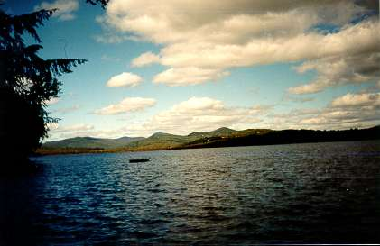
Environmental effects
A 2010 study published in Geophysical Research Letters raised concerns that the growing commercial spaceflight industry could accelerate global warming. The study, funded by NASA and The Aerospace Corporation, simulated the impact of 1,000 suborbital launches of hybrid rockets from a single location, calculating that this would release a total of 600 tonnes of black carbon into the stratosphere. They found that the resultant layer of soot particles remained relatively localized, with only 20% of the carbon straying into the southern hemisphere, thus creating a strong hemispherical asymmetry. This unbalance would cause the temperature to decrease by about 0.4°C in the tropics and subtropics, whereas the temperature at the poles would increase by between 0.2 and 1°C. The ozone layer would also be affected, with the tropics losing up to 1.7% of ozone cover, and the polar regions gaining 5-6%. The researchers stressed that these results should not be taken as "a precise forecast of the climate response to a specific launch rate of a specific rocket type", but as a demonstration of the sensitivity of the atmosphere to the large-scale disruption that commercial space tourism could bring.

Slide 19
Expected economic growth of space tourism
A 2010 report from the Federal Aviation Administration, titled "The Economic Impact of Commercial Space Transportation on the U. S Economy in 2009", cites studies done by Futron, an aerospace and technology-consulting firm, which predicts that space tourism could become a billion-dollar market within 20 years. In addition, in the decade since Dennis Tito journeyed to the International Space Station, eight private citizens have paid the $20 million dollar fee to travel to space. Space Adventures suggests that this number could increase fifteen-fold by 2020. These figures do not include other private space agencies such as Virgin Galactic, which as of 2012 has sold 500 tickets worth $200,000 dollars each. Its ticket sales are expected to increase by the year 2013, when Virgin Galactic expects to begin flights.

Slide 20
Prof. Hawkings in zero g !
http://www.youtube.com/watch?feature=player_embedded&v=0VJqrlH9cdI
Let’s go to space and beyond !!!

