Slide 1
Outreach of Astronomy in
Sri Lanka
(plus how I ended up here in Campos, RJ, Brasil)
Prasanna Deshapriya
President
Mathematical & Astronomical Society
University of Colombo
Sri Lanka
http://iya2009sl.blogspot.com

Slide 2
Astronomical Societies involved in outreach
Mathematical & Astronomical Society (MAS)
Astronomical Association of Sri Lanka (AALK)
Anandian Astronomical Association
SkyLK

Slide 3

Mathematical & Astronomical Society (MAS)
Mathematical & Astronomical Society (MAS) is the astronomical society based in University of Colombo with a proud history of more than 50 years and currently possesses the country’s oldest telescope – The Molesworth Telescope.

Slide 4
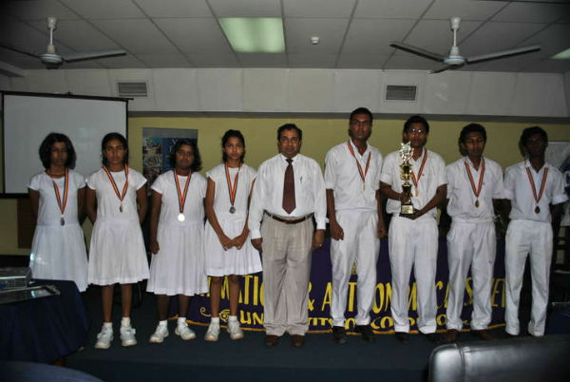
Among its outreach activities “Star Quest” astronomy quiz competition is foremost with the participation of many high-school students from around the island.
The winners and runners-up of the Star Quest 2011

Slide 5
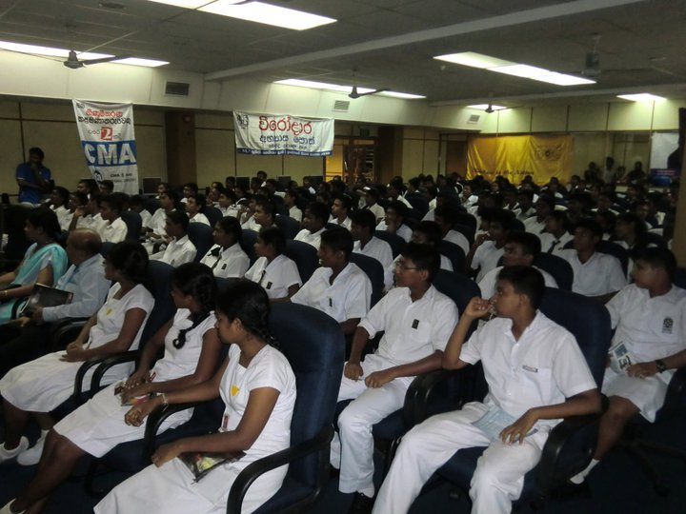
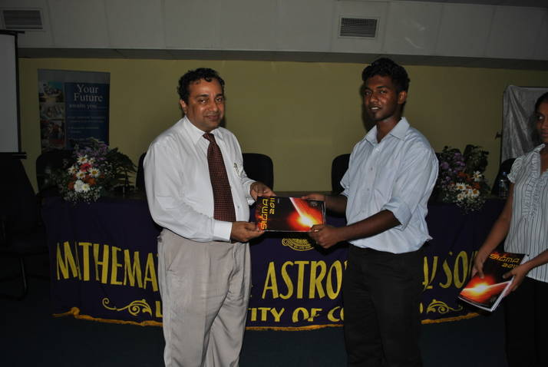
The 34th “Sigma Magazine” was also launched under the guidance of
Dr. Chandana Jayaratne , Senior Lecturer of the Department of Physics and the patron of the MAS.
During the quiz competition-
students waiting at a final round

Slide 6
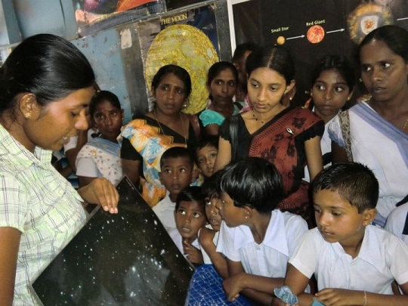
The society also facilitates outstation schools with astronomy workshops and observation camps and these activities are reputed among schools and have a high demand.
Astronomy workshop held
In Anuradhapura
Students with interest amidst an
astronomy session

Slide 7
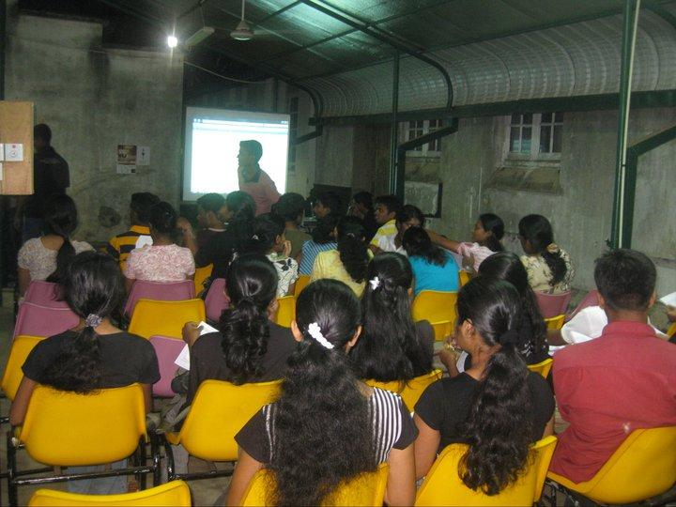
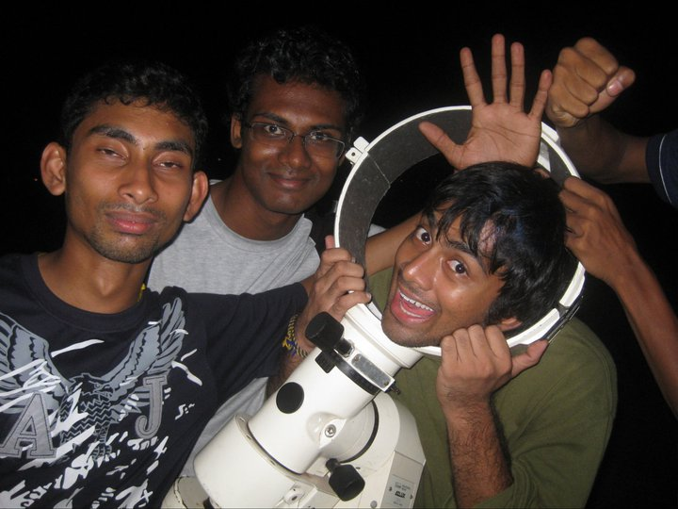
Further the society holds occasional events for university community to cover up interesting aspects of astronomy such as meteor showers, solar eclipses, conjunctions etc.

Slide 8
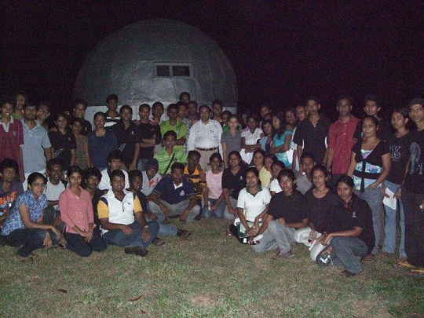
University students at an observation camp, the dome in the background is
where the old Molesworth telescope is housed.

Slide 9

SkyLK
Sri Lankan astronomy information portal
Skylk.com is the first Sri Lankan astronomy information web site in Sinhalese language. The goal is to deliver information about astronomy, space and science to the public in Sri Lanka in a way they can understand clearly.
Website - http://www.skylk.com/

Slide 10
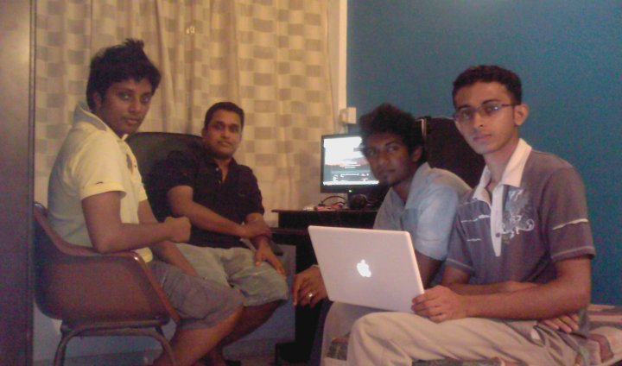
SkyLK Astronomy Podcast
The specialty of the SkyLK podcast was the fact that it was aired in Sinhalese and
therefore many local were interested in astronomy and space science. The podcast was
generally focused on a topic of concurrent interest or some astronomical phenomenon
or even some hardcore area like cosmology, The podcasters were aimed at using the simple language and bringing astronomy closer to people.

Slide 11
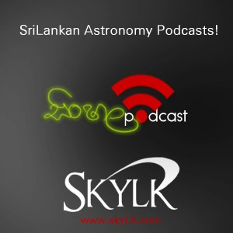
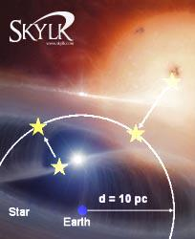
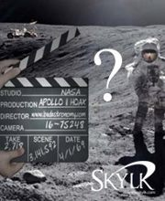
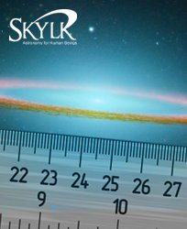
Some of the podcast topics covered

Slide 12
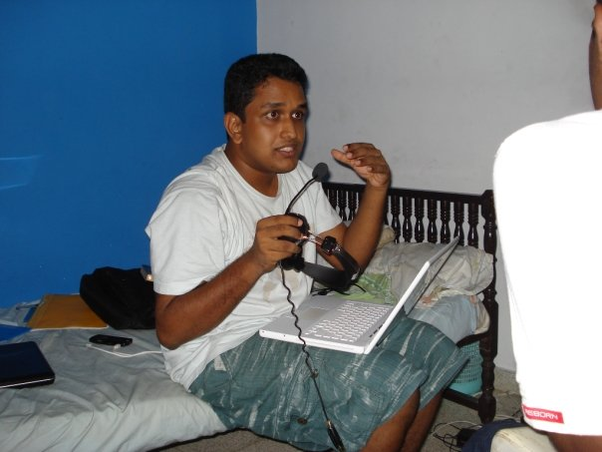
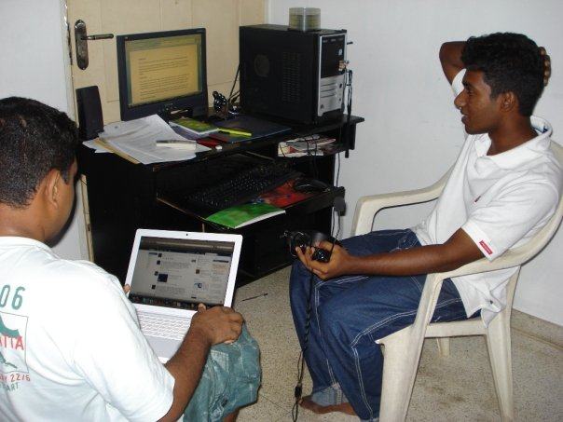
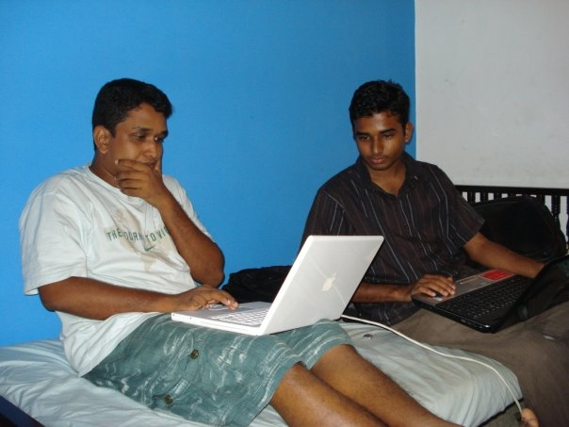
SkyLk Podcast Contributors
(In alphabetical order)
Anuradha Jayathilaka (skylk)
Chathura Manuranga (skylk)
Hasitha Karunarathna (skylk)
Madusha Dedigamuwa (skylk)
Prasanna Deshapriya (aalk)
Pulasthi Kanaththage (assc)
Tharaka Gamage (assc and scitechlk)
Thilina Heenatigala (aalk)

Slide 13
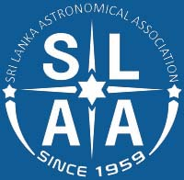
Sri Lanka Astronomical Association - AALK
AALK is also an old and prominent astronomical society engaged with astronomy outreach. There are public lectures being organized occasionally to raise awareness of astronomical events and other activities.
The president of AALK, Prof. Kavan Ratnatunga takes initiative in arranging meetings and lectures whenever a veteran Sri Lankan scientist is back in the country for holidays or when a foreign astronomer is visiting Sri Lanka.
Additionally there is an active online group which discusses about latest updates and facts of curiosity.

Slide 14
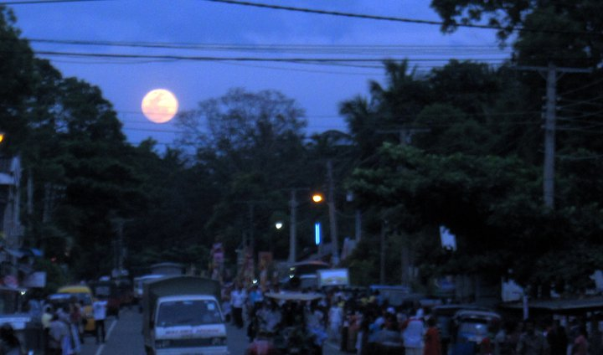
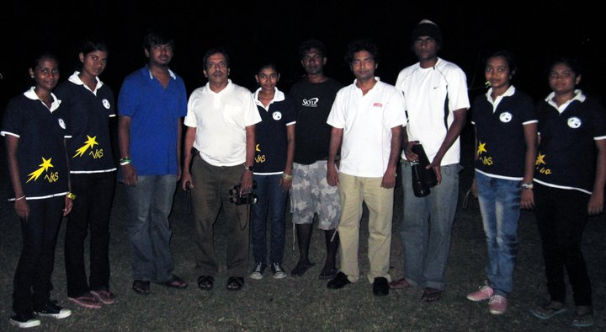
Lunar Eclipse Chase - 2011
Illusion as seen on the way to the lunar eclipse ‘site’ - Embilipitiya
The team that took part in Lunar Eclipse Chase
Notes:
0752183417- Asanga

Slide 15
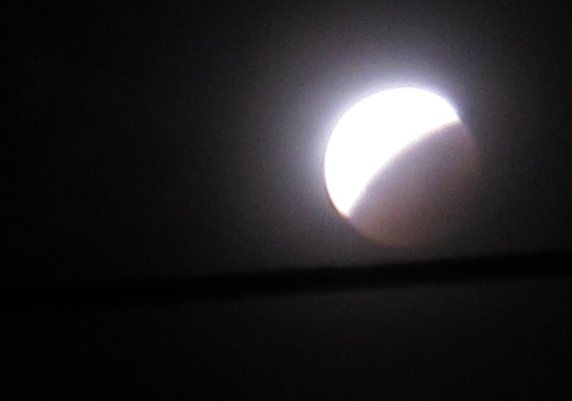
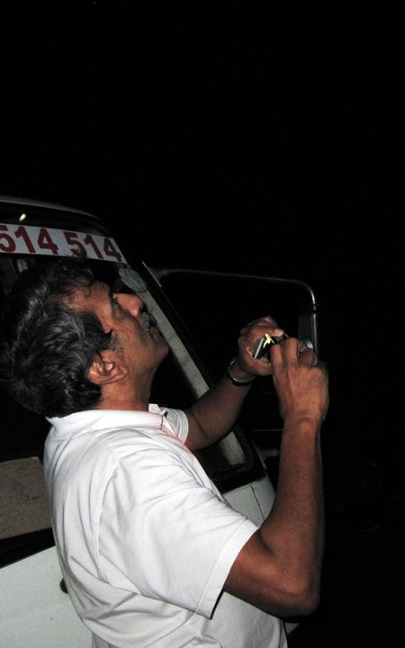
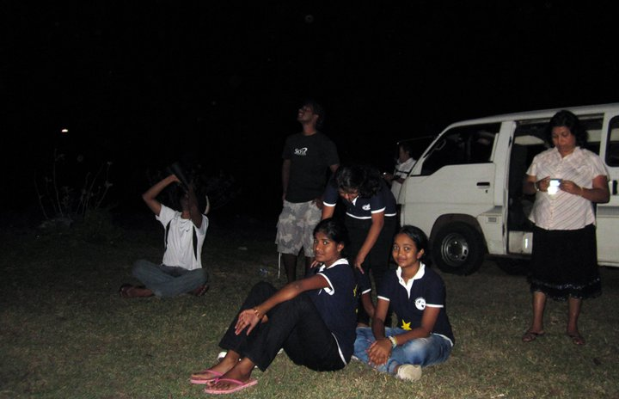
Some on-site snaps taken at Chandrika lake, Embilipitiya

Slide 16
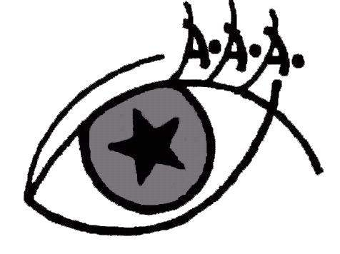
Anandian Astronomical Association - AAA
Anandian Astronomical Association is the astronomical society of Ananda College, Colombo
10 and they’re also a part of outreach endeavors of Sri Lanka with their slogan – “Blending with the Cosmos”
They organize a Star Party and a quiz competition named “Sir Arthur C Clarke Memorial Trophy” each year and these events are attended by large multitudes of young crowd from different parts of the island.
Recently they came up with the project “Astronomy for All” which is aimed at bringing the knowledge of astronomy to villages located far from the capital. This new thread has been able to catch attention with the appreciation of many, thus continuing beyond.

Slide 17
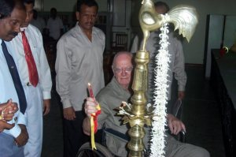
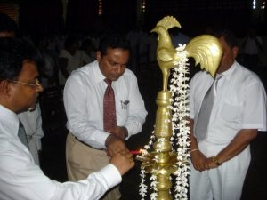
Sir Arthur C Clarke Memorial Quiz Competition
Sir Arthur C Clarke Challenge trophy is the major event of Anandian Astronomical Association as well as among every school based astronomical societies in Sri Lanka. This event is the biggest quiz competition in Sri Lanka and more than 25 schools are represent this event annually. Anandian Astronomical Association organized the primordial competition in 2001 as the 1st challenge trophy in Sri Lanka. This quiz competition was named after British scientist and honorable Sri Lankan citizen; late Sir Arthur C Clarke to respect him and his concepts and he also graced the event as the chief guest in year 2003.

Slide 18
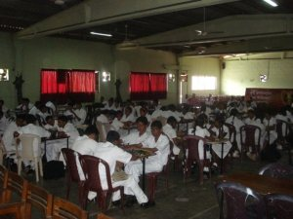
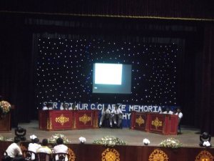
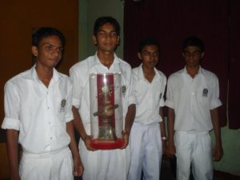
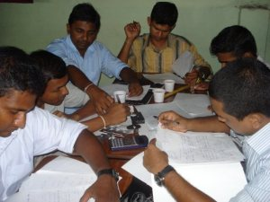

Slide 19
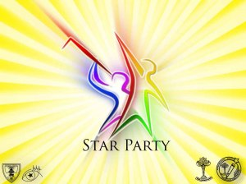
Star Party
As the name hints Star Party is a starry celebration or a stellar night. It’s an event every stargazer is willing forward to participate at. Organized by Anandian Astronomical Association of Ananda College, Colombo along with Astronomical Association of Mahamaya College, Kandy as an affiliated project, Star Party generally focuses on Observational Astronomy, rather than other equivalents of the field.

Slide 20
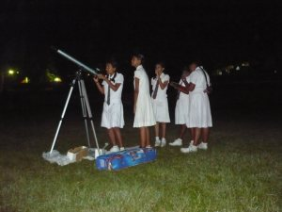
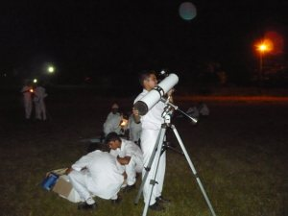
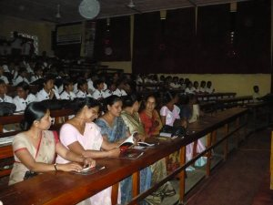

Slide 21
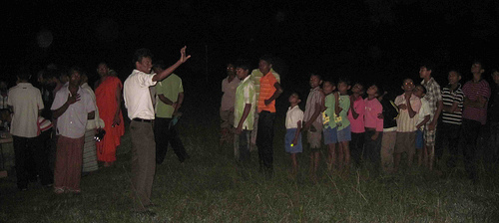
“ගමින් ගමට Astronomy ” - “Astronomy for All” Program
This is an initiative started by Old Anandian Astronomical Association , which comprises of astronomy enthusiasts who have been past-members of the society. They launched a new project in December 2011 to promote observational astronomy among the general people named “ගමින් ගමට Astronomy | Astronomy for all” at Kelagama Vidyalaya, Nikaveratiya and it was a great success with the participation of more than 100 students plus their parents. The content included practical sky observation with naked eye, telescopes and binoculars ,practical activities, lectures, multimedia activities and more.

Slide 22
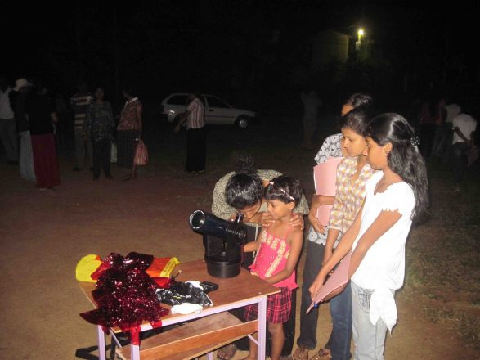
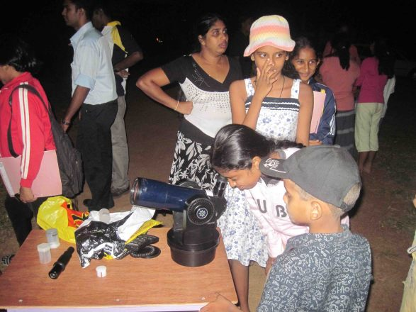
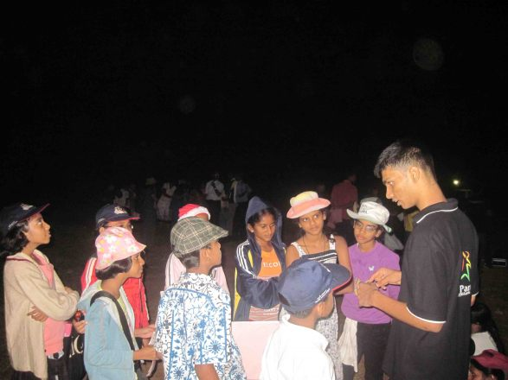
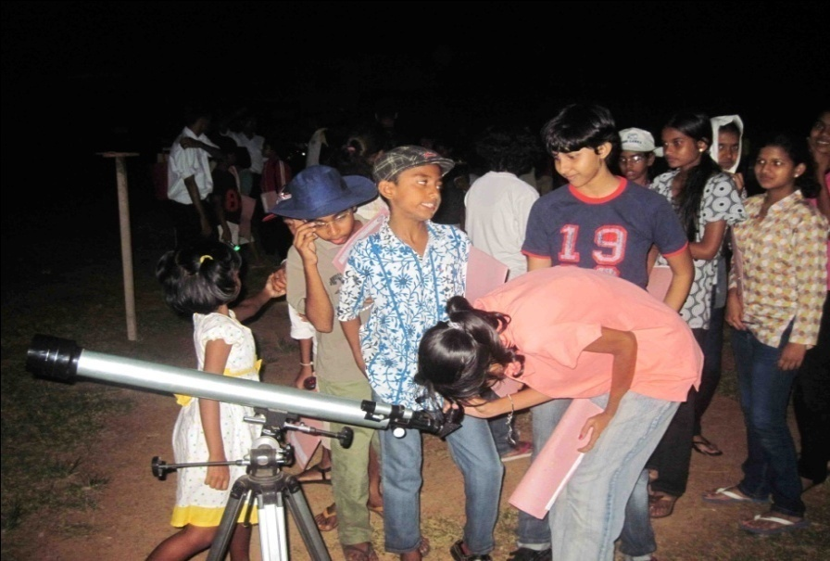
A following second sky observation camp and an Astronomy Workshop was organized at Yakkala “Siyane” housing scheme on 16 th & 17th December 2011.

Slide 23
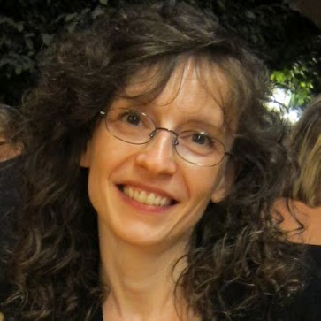
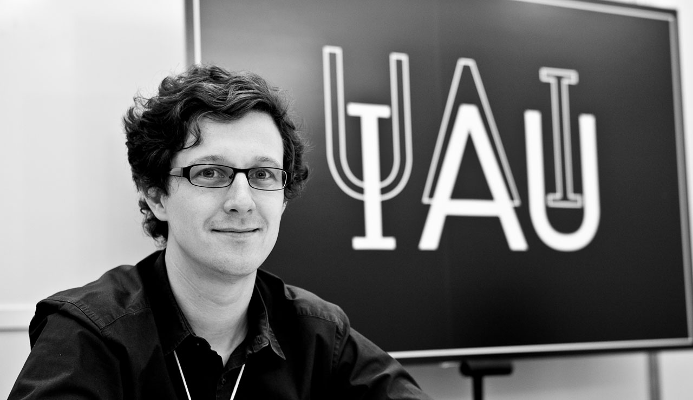
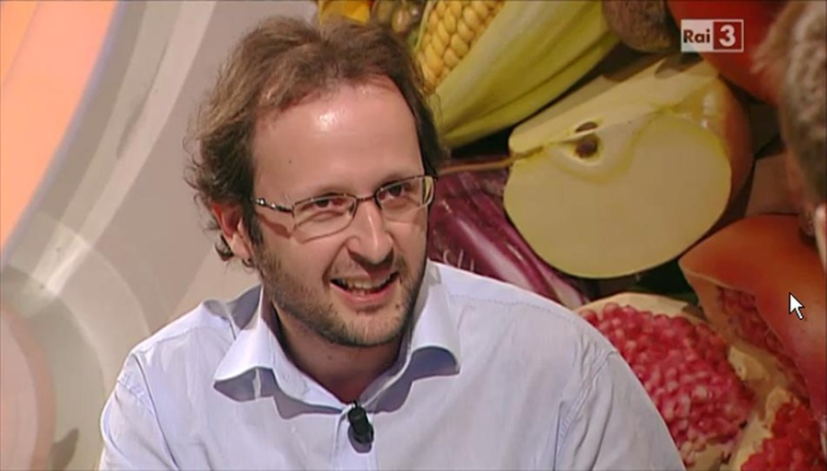
My Involvements in Outreach
My involvement to the astronomy grew more in the International Year of Astronomy 2009 (IYA 2009) as I was collaborating with different international personnel for different projects.

Slide 24
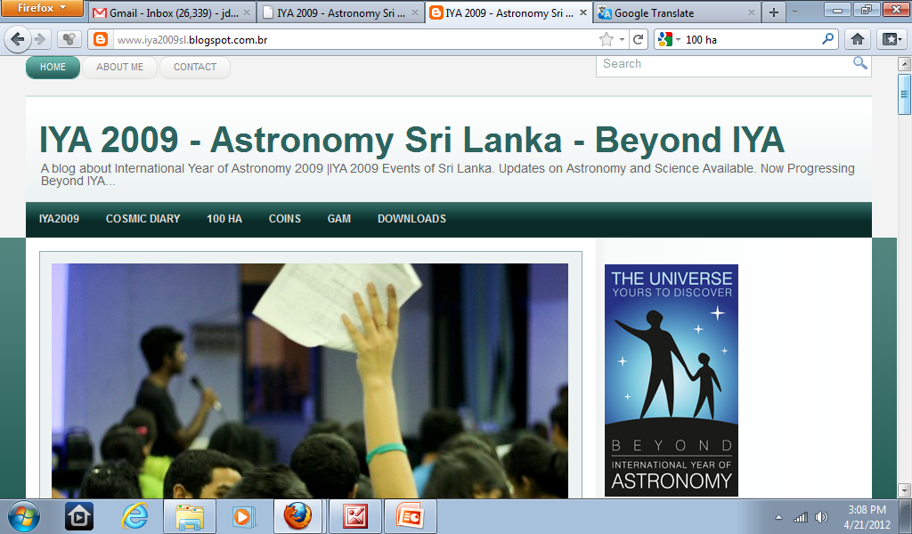
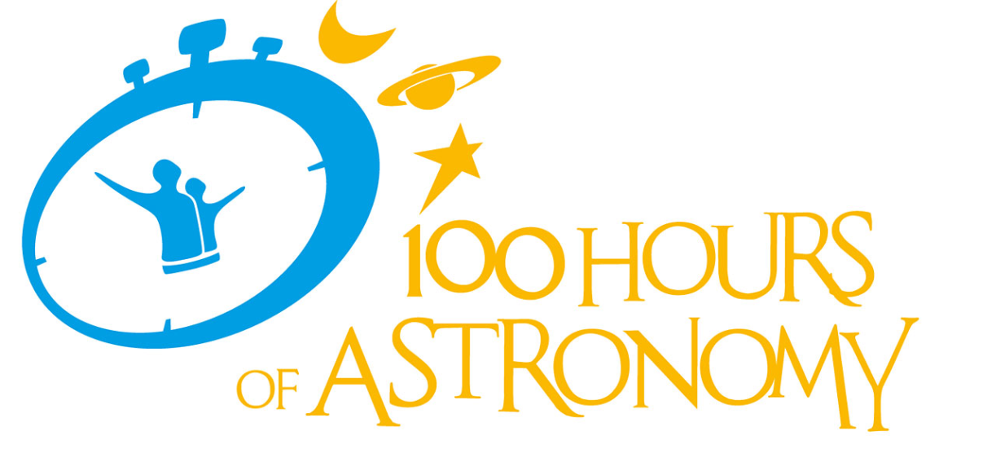
I kept on blogging about astronomy activities happening around the world but with a more focus on those of local as well. I remember we organized outreach camps for 100 HA (Hundred Hours of Astronomy)during April 2009 and then I constantly got engaged with many astronomy observation camps and other activities.

Slide 25
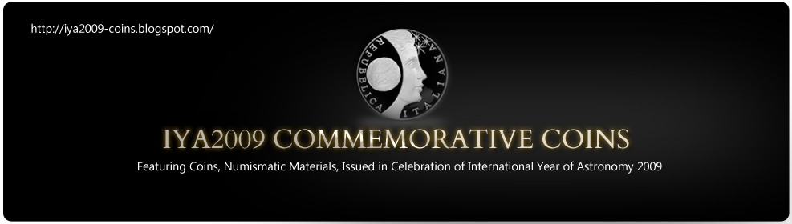
At the time of IYA 2009, there many commemorative coins being minted by different countries and I created a blog gathering information about these memorial coins and it ended up a successful project as I got into contact with Pedro Russo, of IYA 2009 Coordinator and even my account on these coins was published in the final report of IYA 2009, in 2010. I got really motivated by this as it was such an amazing experience finding information about these coins, and sometimes I had to get in contact with official people from national bodies, for example in the case of Hungary.
Finally I was glad that I managed to do something different and contribute to
the IYA 2009, which was a global project for the noble cause of astronomy. Further many numismatists found my work informative and it was also a project of sharing astronomical and numismatic values.

Slide 26
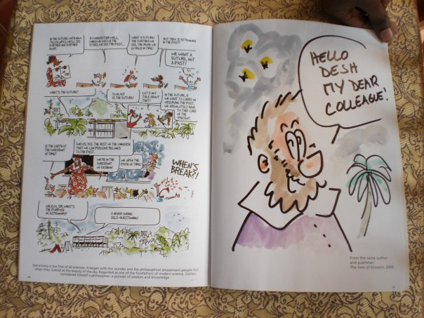

I also collaborated with Sabrina Masiero, of Padua, Italy and we shared the IYA2009 with the general purpose of bringing the idea to a wider reach, specially the children, and youth. "Lives of Galileo" was a comic book
by the author Fermi from Switzerland and Sabrina translated it to Italian and published, I was in contact with her and wanted to do the same with my language, Sinhalese and unfortunately it failed as it was not possible to find a sponsor to get the legal copyrights transferred. Nevertheless, Fiami was kind enough to send me an autographed copy of Lives of Galileo"

Slide 27
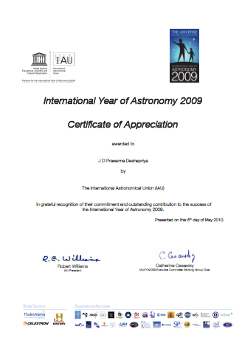
Finally I received a certificate from IAU for my work during IYA 2009.
Then it was the time of 2010 and I continued with more outreach activity as was adopted the general theme "Beyond IYA 2009"

Slide 28
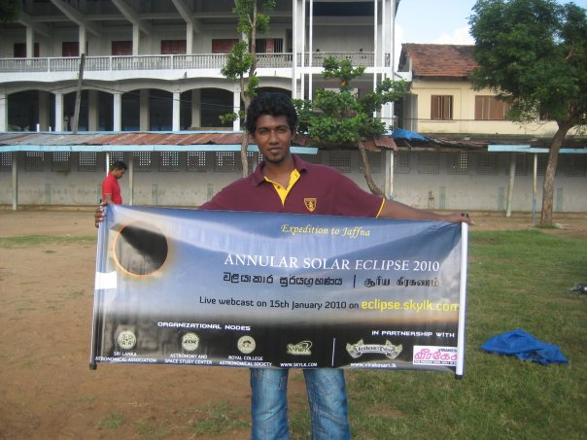
The annular solar eclipse 2010 was due on 15th of January and I got together with my colleagues and we wanted to organize some outreach expedition for the eclipse.

Slide 29
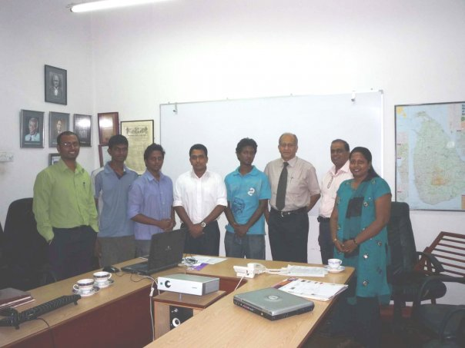
Although the main line of the eclipse lied across Sri Lanka, it was through Jaffna peninsula, the north of Sri Lanka, which posed the problem of traveling there with the telescopes and other gear. At the same time I was publishing about this in my blog and fortunately a Newspaper company - Weerakesari, contacted me and ended up sponsoring our expedition to Jaffna. We had a lot of audience, flocking around the ground we were and also we managed to show the eclipse to many students and for many of them, it was their first time observing a solar eclipse.

Slide 30
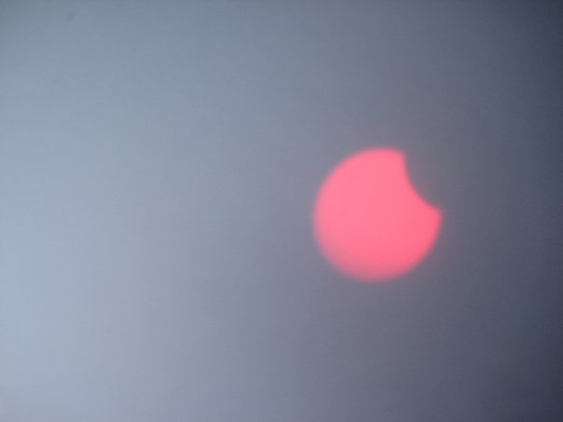
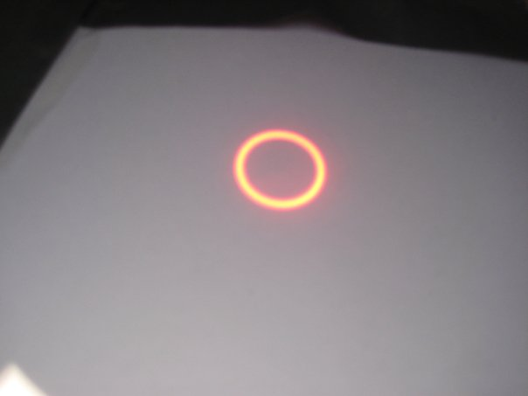
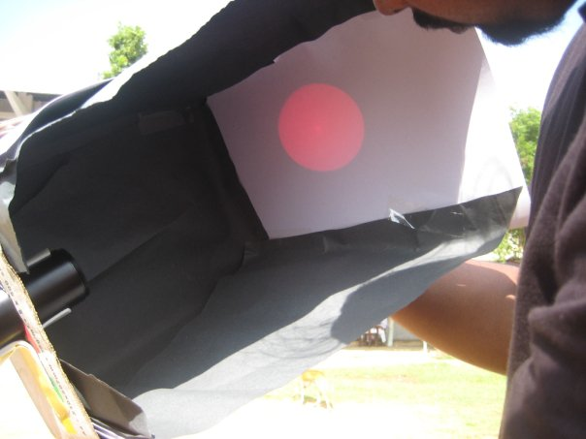


Slide 31

Jaffna, Sri Lanka

Slide 32

Another story with an eclipse – A total one

Slide 33

Currently I engage in astronomy outreach as the president of Mathematical and
Society of University of Colombo
A picture taken during the Annual General Meeting. Jan 2012

Slide 34
Be Inspired !!
“What is written is written,
Only those inspired can change the writing !!”
Dirk Ross

Slide 35
Muito Obrigado !!

